Slide 1


Person Recognition System For Blind
DR.K.N.MODI GLOBAL SCHOOL
INNOVATION KNOWS NO BOUNDARY
Presented by:
INNOVATOR CLUB

Slide 2
Contents
Introduction
Literature Survey and problem identification
Scope and Objectives of the Project
Platform Used
Working Of The Project
Conclusion
References

Slide 3
Introduction
To Recognize person information for Blind Person is the major problem all over the world. We can solve this problem by using AI techniques.
Although not all countries are equally infested with this problem, a significant contribution for the blind by Using AI is possible for every country.
We use AI (Computer Vision) Technique to overcome this problem as this model will store the information of the person and will detect the person next time and give the information to the blind.

Slide 4
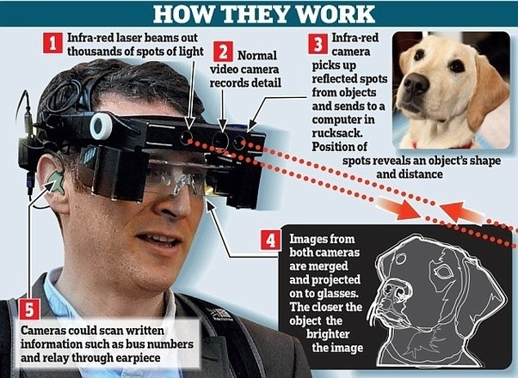
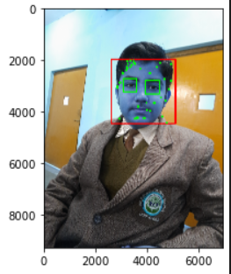
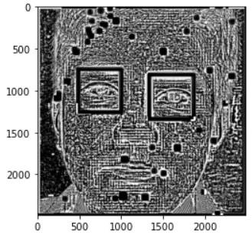
Literature Survey and problem identification
[1] Yajush , Naitik & Rishabh got an idea to solve the problem of person recognition System Based On AI after lookup the object detection System Viola-Jones framework proposed in 2001 by Paul Viola and Michael Jones in the paper Robust Real-time Object Detection
Introduced Classification Devices , AI Technologies(eg. Computer Vision)

Slide 5
Scope and Objectives of the Project
The main objectives of our project are:
Making blind people more independent.
Providing person Detail, also we can add facial expression.
Skull Conduction system to provide information in form of voice.
providing sensor sensed data to improve project efficiency
Providing all these features in a compact wearable glass.

Slide 6
Platform Used
JUPYTER NOTEBOOK : Jupyter Notebook combines live code, graphics, visualizations, and text in shareable notebooks that run in a web browser.
V.S CODE : VS Code,^{[10]} is a source-code editor made by Microsoft with the Electron Framework, for Windows, Linux and macOS.^{[11]} Features include support for debugging, syntax highlighting, intelligent code completion, snippets, code refactoring, and embedded Git.
FATKUN BATCH : Fatkun Batch is a Image download extension.
HAAR CASCADE : Haar cascade for object detection to detect eyes and faces
Programming Languages : Python, Html, CSS, .Js

Slide 7
Working of The Project
Preprocessing :
a) Detect face and eyes :
We use haar cascade from opencv to Load image, detect face. If eyes =2, then crop the face region
b) Wavelet transformation:
Raw pixel image can be used as an input for our classifier.
2. Data Cleaning :
a) Scaling the raw images :
scalled_raw_img = cv2.resize(img, (32, 32))
b) Reshaping the images :
combined_img = np.vstack((scalled_raw_img.reshape(32*32*3,1),scalled_img_har.reshape(32*32,1)))

Slide 8
Working of The Project
3. Model Selection :
a) Train-Test Split Standardizing Data :
To split Dataset into Training data and Testing data
b) GridSearchCV :
GridSearch to try out different models with different parameters. Goal is to come up with best modle with best fine tuned parameters
Save Model And Class Dictionary
a) Pickle File :
Save the model as a pickle in a file
b) Json File :
Class_dictionary.json file to Classify Person by number.

Slide 9
Conclusion
We Use GridSearch to try out different models with different parameters. And we find that Logistic Regression is performing well.
As one of the important tasks, going out can never be the only need of the blind, and other sometimes be challenging as well: human Identified interactions with the environment are realized through vision and I believe that artificial intelligence can at lease remove a part of this limitation for the blind. I am open to more suggestions and discussions.

Slide 10
References
There are several AI projects that focus specifically on improving accessibility for blind individuals who have been identified as human, such as:
Face recognition for blind individuals: AI-powered face recognition systems can help blind individuals
identify people they are interacting with, such as family members or coworkers.
These are some examples of AI-based projects that can be used to improve accessibility for blind individuals who have been identified as human.
Detect face and eyes
OpenCV haar Cascade | Guide to OpenCV haar Cascade (educba.com)
Model Selection
How to split a Dataset into Train and Test Sets using Python – GeeksforGeeks
GridSearchCV
sklearn.model_selection.GridSearchCV — scikit-learn 1.2.0 documentation

Slide 11
THANK YOU!

